Slide 1
Data Structures
20. AVL Trees

Slide 2
Balanced and Unbalanced BST
1
4
2
2
5
3
1
3
4
4
Is this “balanced”?
5
2
6
6
1
3
5
7
7

Slide 3
Balanced Tree
Want a (almost) complete tree after every operation
Tree is complete except possibly in the lower levels towards right
Maintenance of such a tree is expensive
For example, insert 2 in the tree on the left and then rebuild as a complete tree
6
5
Insert 2 &
complete tree
4
9
2
8
1
5
8
1
4
6
9

Slide 4
AVL Trees – Good but not Perfect Balance
Named after Adelson-Velskii and Landis
Balance is defined by comparing the height of the two sub-trees
Recall:
An empty tree has height –1
A tree with a single node has height 0

Slide 5
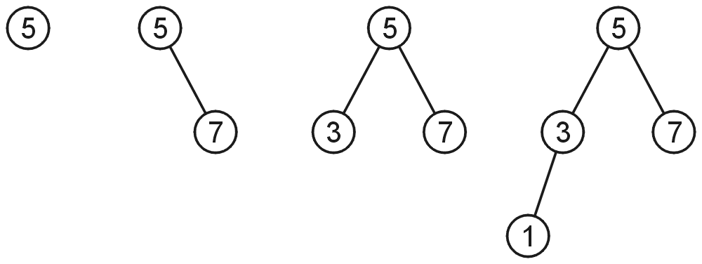
AVL Trees
A binary search tree is said to be AVL balanced if:
The difference in the heights between the left and right sub-trees is at most 1, and
Both sub-trees are themselves AVL trees
AVL trees with 1, 2, 3 and 4 nodes

Slide 6
AVL Trees – Example
5
7
2
8
2
8
1
4
7
1
4
3
3
5
An AVL Tree
Not an AVL Tree

Slide 7
AVL Trees – Balance Factor
An AVL tree has balance factor calculated at every node
Height of the left subtree minus the height of the right subtree
For an AVL tree, the balances of the nodes are always -1, 0 or 1
Height of node = h
Balance Factor (BF) = h_{left} - h_{right}
Empty height = -1
Tree A (AVL)
Tree B (AVL)
6
height=2 BF=1-0=1
6
1
4
9
0
4
9
0
0
1
5
-1
-1
1
5
8
-1
-1
-1
-1
-1
-1
-1
-1
-1
-1
-1

Slide 8
AVL Trees – Example
Tree A (AVL)
Tree B (not AVL)
3
balance factor
1-(-1) = 2
6
6
2
4
9
4
9
1
-1
1
5
7
1
5
8
0
7
Height of node = h
Balance factor = h_{left}-h_{right}
Empty height = -1

Slide 9
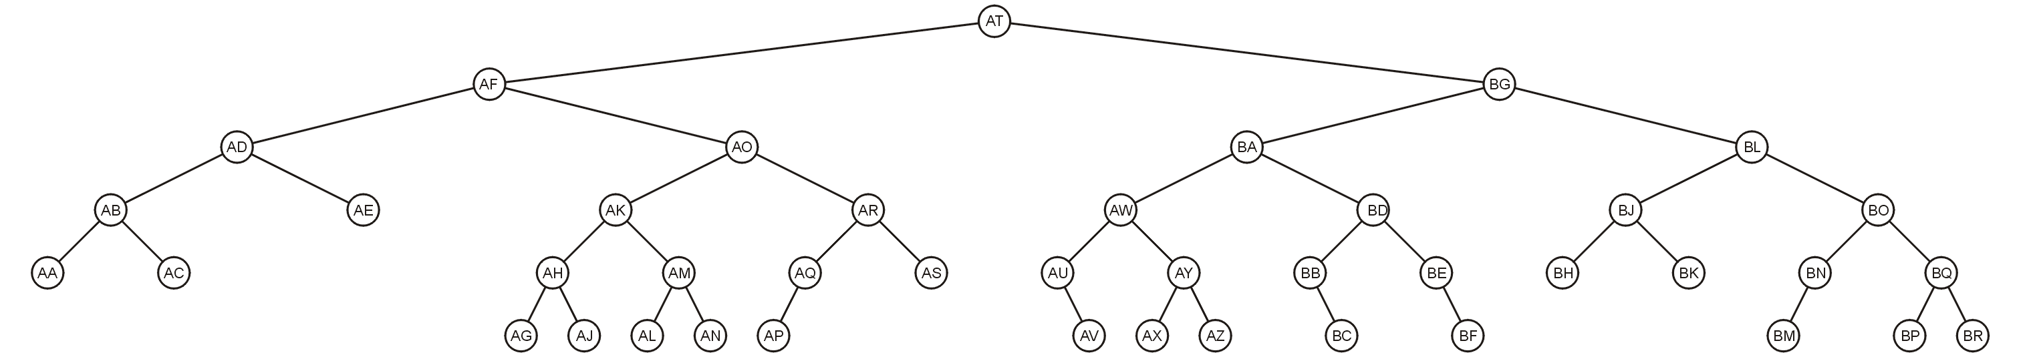
AVL Trees – Example
Here is a larger AVL tree (42 nodes)

Slide 10
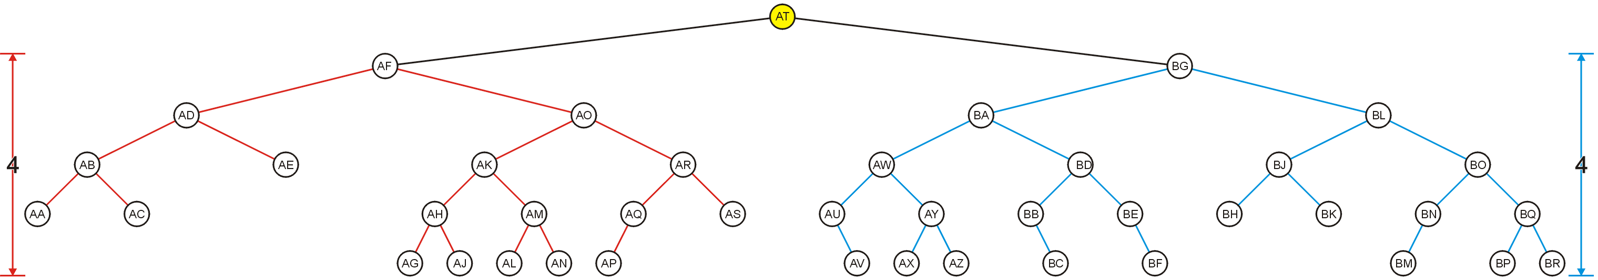
AVL Trees – Example
The root node is AVL-balanced
Both sub-trees are of height 4 (i.e., at root BF = 0)

Slide 11
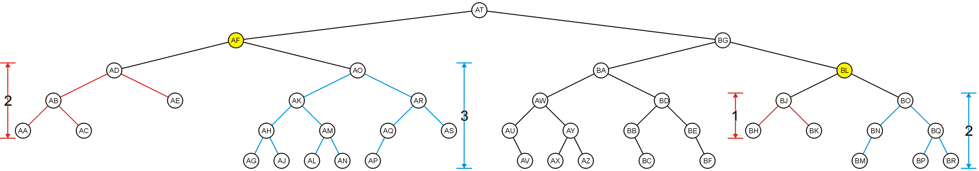
AVL Trees – Example
All other nodes (e.g., AF and BL) are AVL balanced
The sub-trees differ in height by at most one

Slide 12
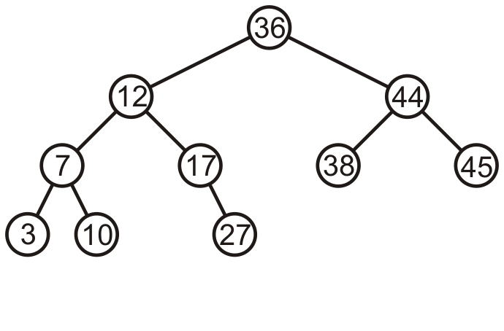
AVL Trees – Example
Consider this AVL tree

Slide 13
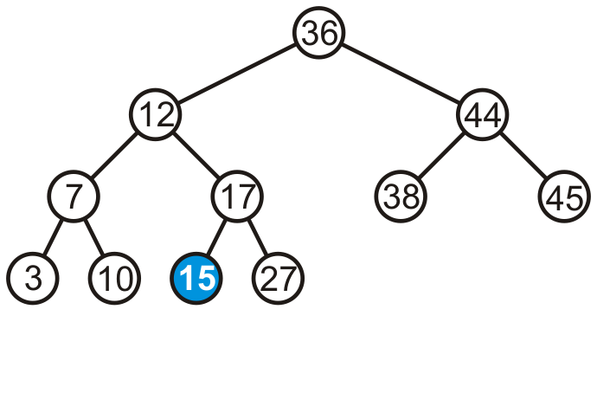
AVL Trees – Example
Consider inserting 15 into this tree
In this case, the heights of none of the trees change
Tree remains balanced

Slide 14
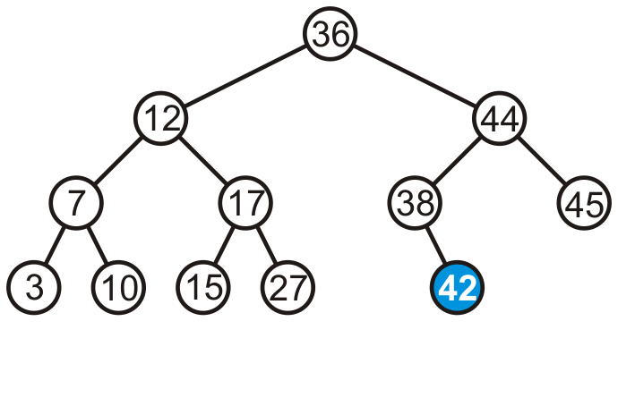
AVL Trees – Example
Consider inserting 42 into this tree

Slide 15
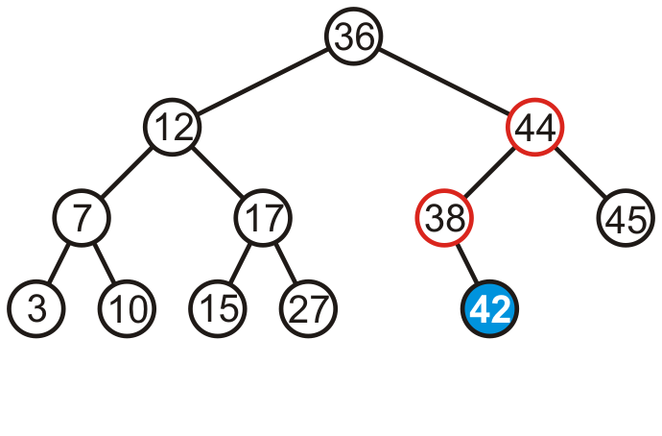
AVL Trees – Example
Consider inserting 42 into this tree
Height of two sub-trees rooted at 44 and 38 have increased by one
The tree is still balanced

Slide 16
AVL Trees
To maintain the height balanced property of the AVL tree, it is necessary to perform a transformation on the tree so that
In-order traversal of the transformed tree is the same as for the original tree (i.e., the new tree remains a binary search tree)
Perform a transformation on the tree

Slide 17
AVL Trees
To maintain the height balanced property of the AVL tree, it is necessary to
Perform a transformation on the tree, such that
In-order traversal of the transformed tree is the same as for the original tree (i.e., the new tree remains a binary search tree)

Slide 18
Transformation (Rotation) of AVL Trees
Insert operations may cause balance factor to become 2 or –2 for some node
Only nodes on the path from insertion point to root node have possibly change in height
Follow the path up to the root, find the first node (i.e., deepest) whose new balance violates the AVL condition
Call this node “a”
If a new balance factor (the difference h_{left}-h_{right}) is 2 or –2
Adjust tree by rotation around the node “a”

Slide 19
Balancing AVL Trees – Example
If a tree is AVL balanced, for an insertion to cause an imbalance:
The heights of the sub-trees must differ by 1
The insertion must increase the height of the deeper sub-tree by 1

Slide 20
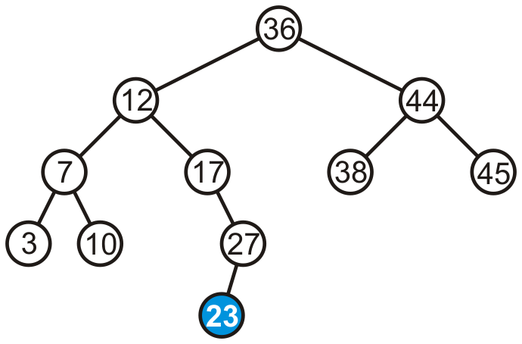
Balancing AVL Trees – Example
Suppose we insert 23 into our initial tree

Slide 21
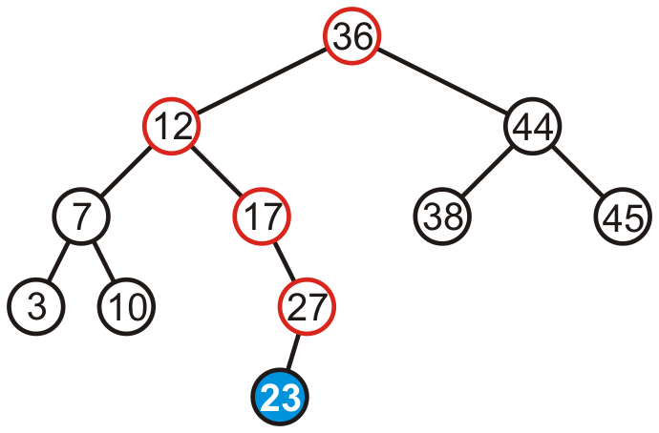
Balancing AVL Trees – Example
The heights of each of the sub-trees from the insertion point to the root are increased by one

Slide 22
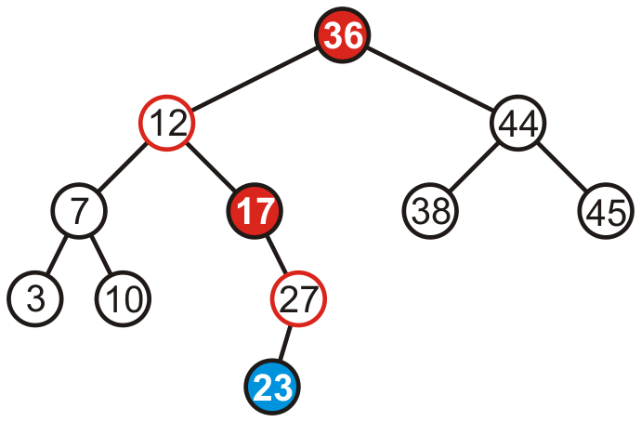
Balancing AVL Trees – Example
Only two of the nodes are unbalanced, i.e., 17 and 36
Balance factor of 17 is -2
Balance factor of 36 is 2

Slide 23
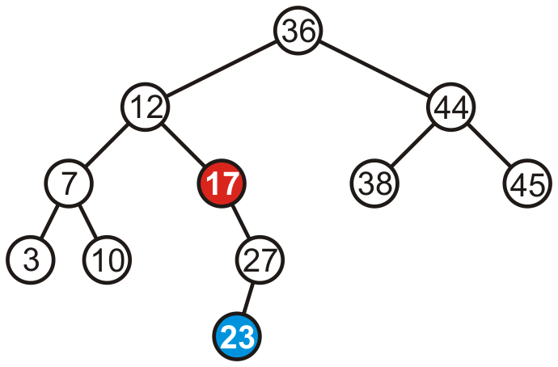
Balancing AVL Trees – Example
We only have to fix the imbalance at the lowest node

Slide 24
Fixing Imbalance By Rotation
Let the node that needs rebalancing be “a”
Imbalance during insertion may be handled using four cases
Outside cases (Single Rotation)
Right rotation (case RR)
Left rotation (case LL)
Inside cases (Double Rotation)
Right-left rotation (case RL)
Left-right rotation (case LR)

Slide 25
Single Rotation in an AVL Tree
2
2
6
6
1
2
1
1
4
9
4
8
0
0
1
0
0
0
0
1
5
8
1
5
7
9
0
7

Slide 26
Right Rotation (RR) in an AVL Tree
Node “b” becomes the new root
Node “b” takes ownership of node “a”, as it's right child
Node “a” takes ownership of node “b” right child (NULL if no child)
As left child of node “a”
a
b
b
c
a
c

Slide 27
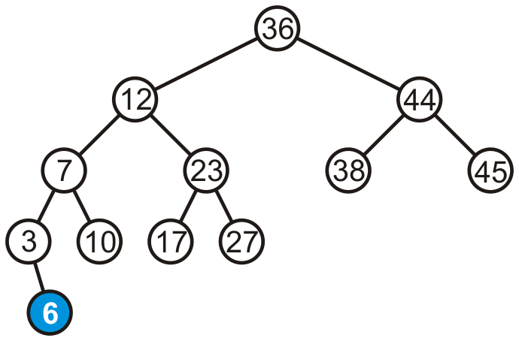
Right Rotation (RR) – Example
Consider adding 6

Slide 28
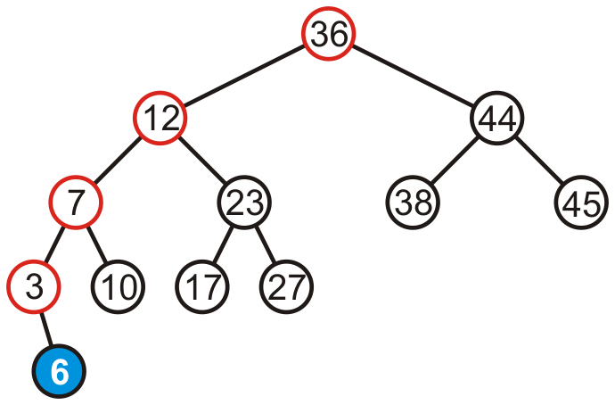
Right Rotation (RR) – Example
Height of each of the trees in the path back to the root are increased by one

Slide 29
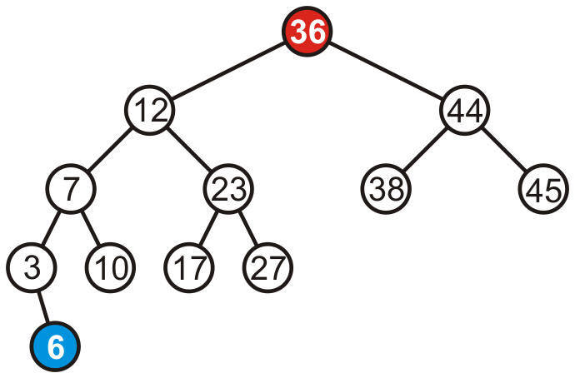
Right Rotation (RR) – Example
Height of each of the trees in the path back to the root are increased by one
Only root node (i.e., 36) violates the balancing factor

Slide 30
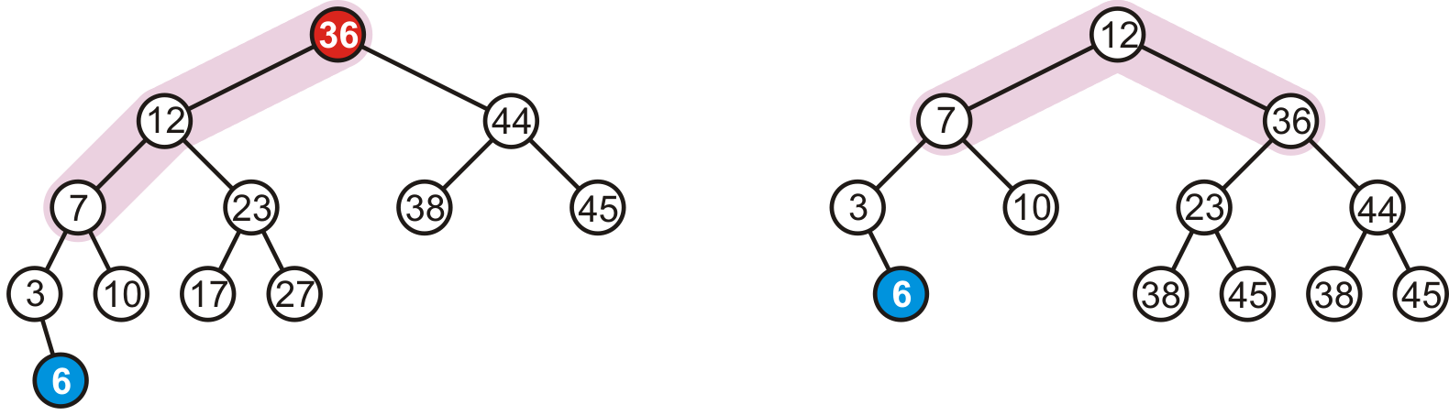
Right Rotation (RR) – Example
To fix the imbalance, we perform right rotation of root (i.e., 36)
17
27

Slide 31
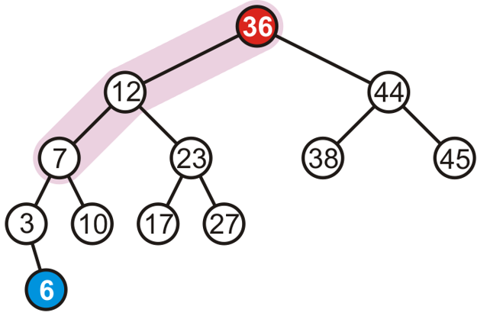
When to Perform Right Rotation (RR)?
Let the node that needs rebalancing be “a”
Case RR
Insertion into left subtree of left child of node “a”
Left tree is heavy (i.e., h_{left} > h_{right} )

Slide 32
When to Perform Right Rotation (RR)
Let the node that needs rebalancing be a
Case RR
Insertion into left subtree of left child of node a (RR)
Left tree is heavy (i.e., h_{left} > h_{right} )

Slide 33
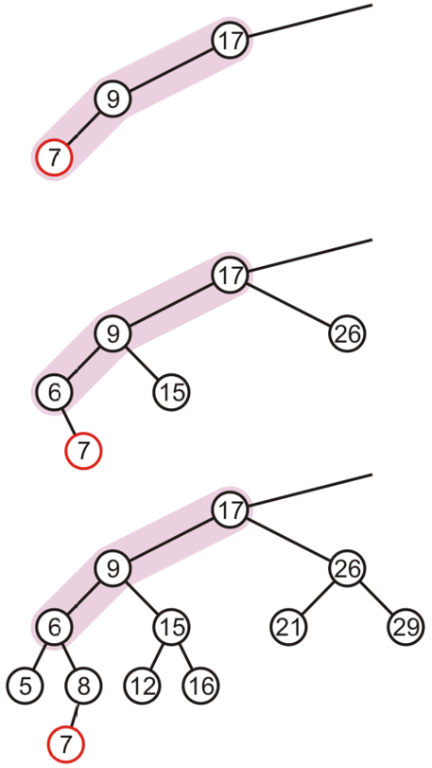
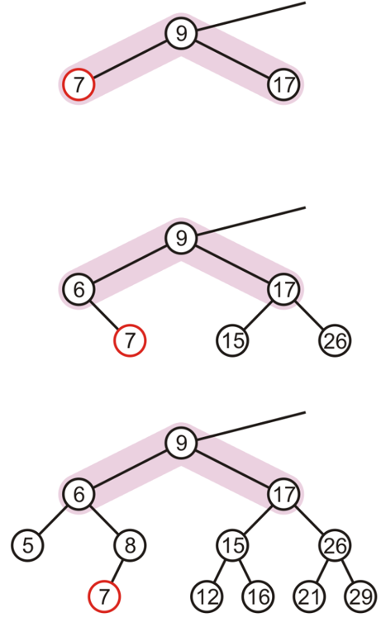
Right Rotation (RR) – Examples

Slide 34
Left Rotation (LL) in an AVL Tree
Node “b” becomes the new root
Node “b” takes ownership of node “a” as its left child
Node “a” takes ownership of node “b” left child (NULL if no child)
As right child of node “a”
a
b
b
a
c
c

Slide 35
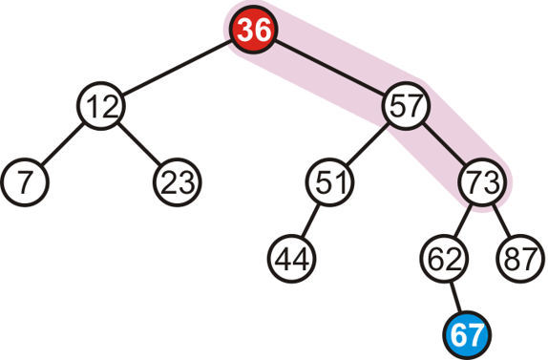
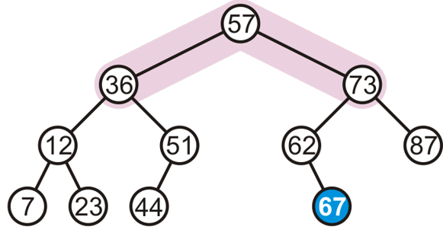
Left Rotation (LL) – Example
Consider adding 67
To fix the imbalance, we perform left rotation of root (i.e., 36)

Slide 36
When to Perform Left Rotation (LL)
Let the node that needs rebalancing be “a”
Case LL
Insertion into right subtree of right child of node a
Right tree is heavy (i.e., h_{left} < h_{right} )

Slide 37
When to Perform Left Rotation (LL)
Let the node that needs rebalancing be a
Case LL
Insertion into right subtree of right child of node a (LL)
Right tree is heavy (i.e., h_{left} < h_{right} )

Slide 38
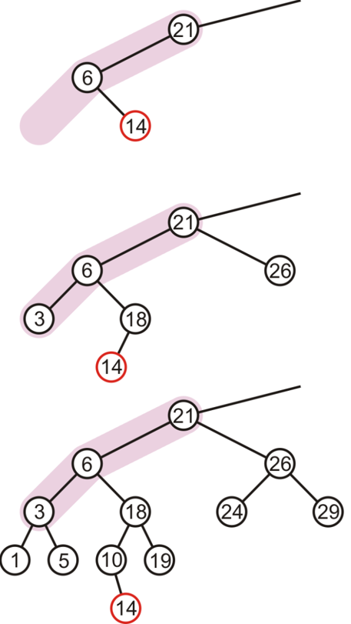
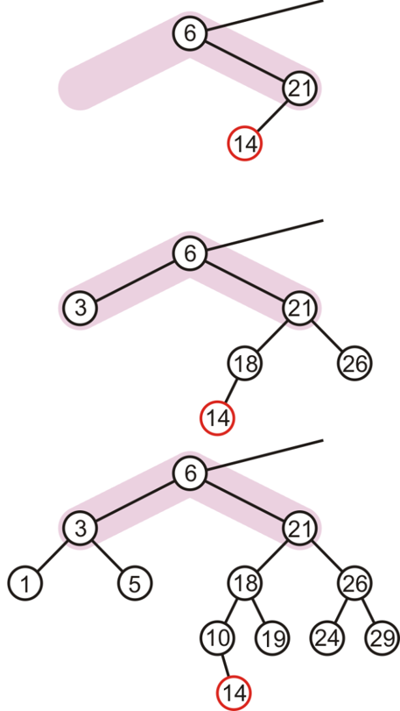
Single Rotation May Be Insufficient
The imbalance is just shifted to the other side

Slide 39
Right-Left Rotation (RL) or "Double Right"
c
c
b
Right
a
b
Left
a
c
b
a
Perform a left rotation on the left subtree
Node “b” becomes the new root
Node “b” takes ownership of node “c” as its right child
Node “c” takes ownership of node “b” right child
As its left child

Slide 40
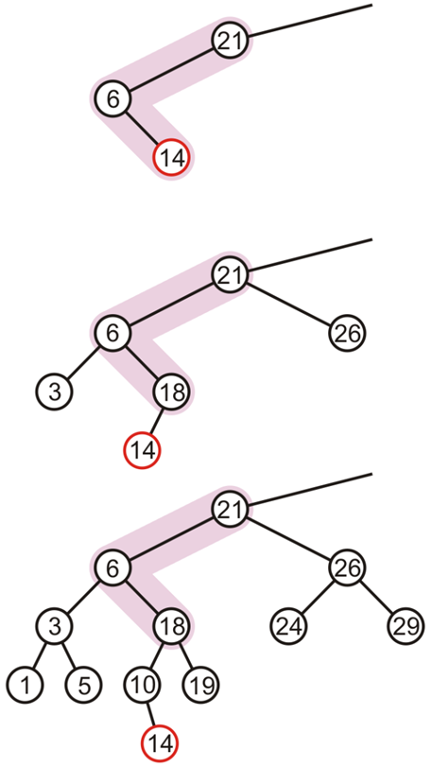
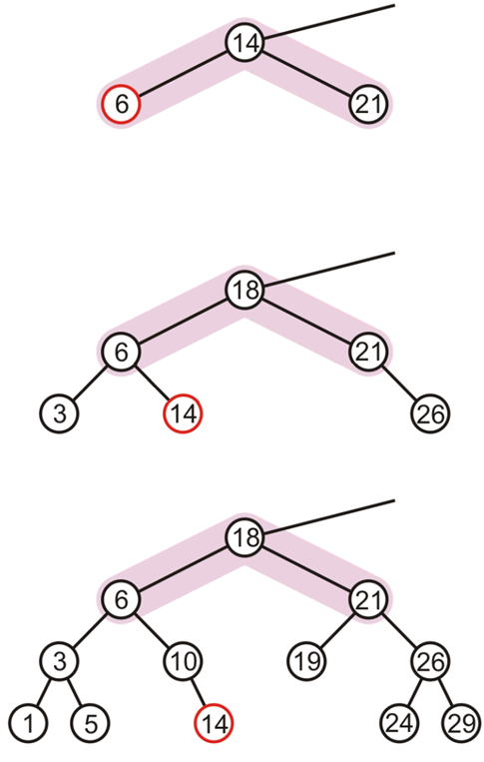
Right-Left Rotation (RL) or "Double Right" – Example

Slide 41
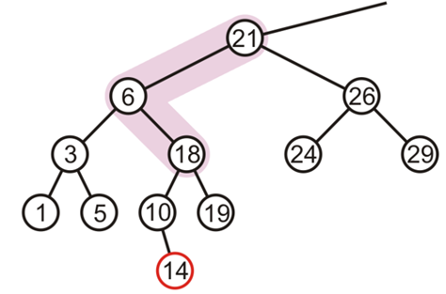
When to Perform Right-Left Rotation (RL)
Let the node that needs rebalancing be “a”
Case RL
Insertion into right subtree of left child of node “a”

Slide 42
When to Perform Right-Left Rotation (RL)
Let the node that needs rebalancing be a
Case RL
Insertion into right subtree of left child of node a (RL)
Left heavy
Right heavy

Slide 43
Left-Right Rotation (LR) or "Double Left"
a
a
b
Left
c
b
a
c
Right
b
c
Perform a right rotation on the right subtree
Node “b” becomes the new root
Node “b” takes ownership of node “a” as its left child
Node “a” takes ownership of node “b” left child
As its right child

Slide 44
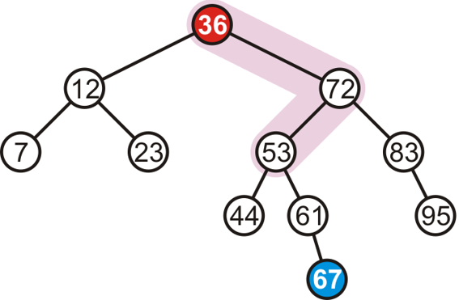
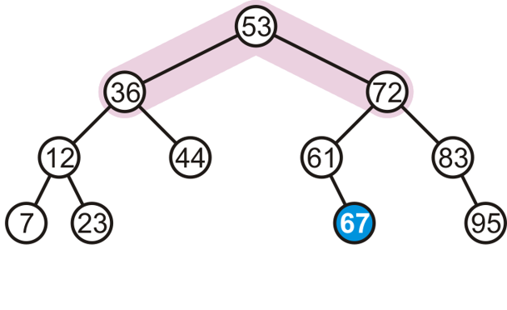
Left-Right Rotation (LR) or "Double Left" – Example
Consider adding 67
To fix the imbalance, we perform left-right (LR) rotation of root

Slide 45
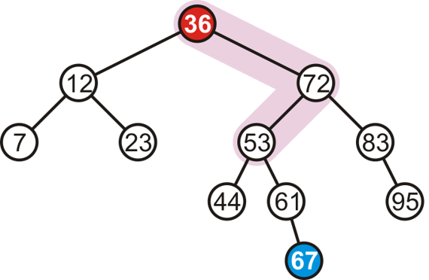
When to Perform Left-Right Rotation (LR)
Let the node that needs rebalancing be a
Case LR
Insertion into left subtree of right child of node a

Slide 46
When to Perform Left-Right Rotation (LR)
Let the node that needs rebalancing be a
Case LR
Insertion into left subtree of right child of node a (LR)
Right heavy
Left heavy

Slide 47
Summary: How And When To Rotate?
Let the node that needs rebalancing be “a”
Violation during insertion may occur in four cases
Outside cases (Single Rotation)
Insertion into left subtree of left child of node a (case RR)
Insertion into right subtree of right child of node a (case LL)
Case 1: RR
Case 2: LL

Slide 48
Summary: How And When To Rotate?
Let the node that needs rebalancing be “a”
Violation during insertion may occur in four cases
Inside cases (Double Rotation)
Insertion into right subtree of left child of a (case RL)
Insertion into left subtree of right child of a (case LR)
Case 3: RL
Case 4: LR

Slide 49
Summary: How And When To Rotate?
if tree is right heavy {
if tree's right subtree is left heavy {
Perform Left-Right rotation
}
else {
Perform Single Left rotation
}
}
…
…
else if tree is left heavy {
if tree's left subtree is right heavy {
Perform Right-Left rotation
}
else {
Perform Single Right rotation
}
}

Slide 50
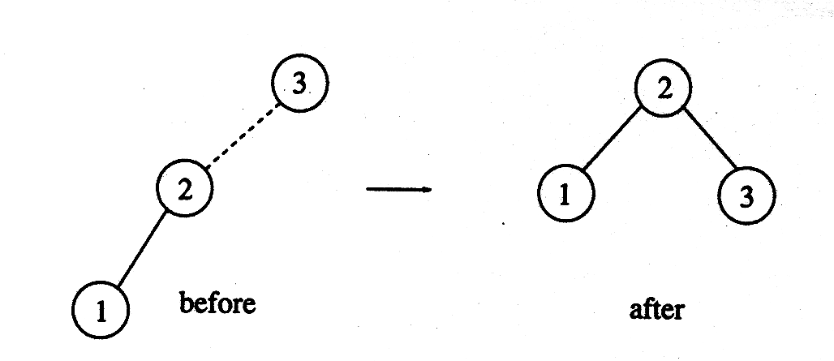
AVL Tree – Complete Example
Construct AVL Tree with the following input elements
3, 2, 1, 4, 5, 6, 7
Insert 3, 2, 1
Insert 4, 5

Slide 51
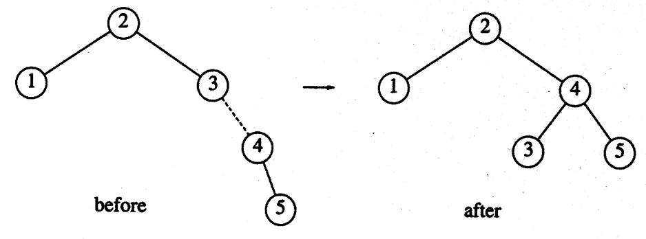
AVL Tree – Complete Example
Construct AVL Tree with the following input elements
3, 2, 1, 4, 5, 6, 7
Insert 4, 5
Insert 6

Slide 52
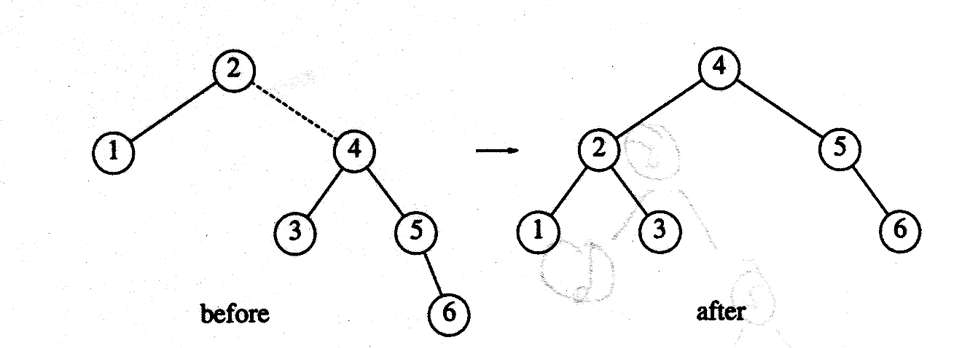
AVL Tree – Complete Example
Construct AVL Tree with the following input elements
3, 2, 1, 4, 5, 6, 7
Insert 6
Insert 7

Slide 53
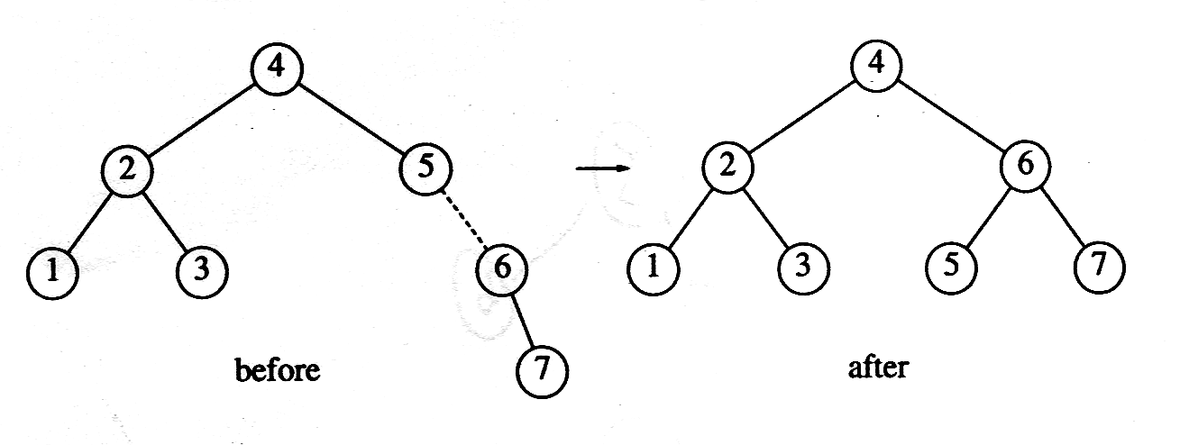
AVL Tree – Complete Example
Construct AVL Tree with the following input elements
3, 2, 1, 4, 5, 6, 7
Insert 7

Slide 54
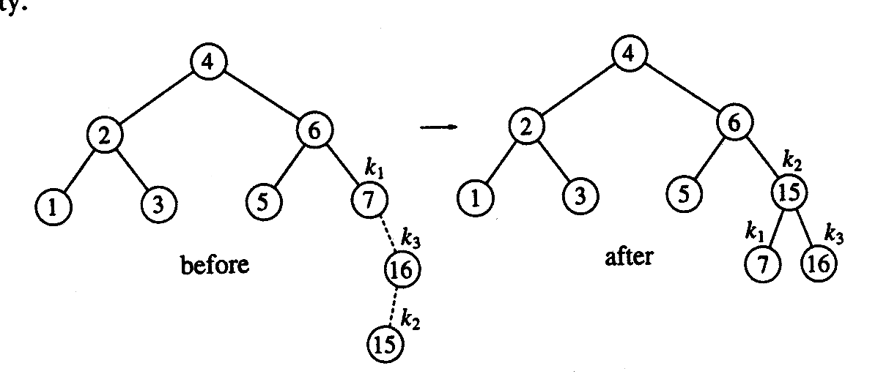
AVL Tree – Complete Example
Suppose the following elements have to be inserted further
16, 15, 14, 13, 12, 11, 10, 8
Insert 16, 15
Insert 14
Notes:
LR Rotation → First right then left

Slide 55
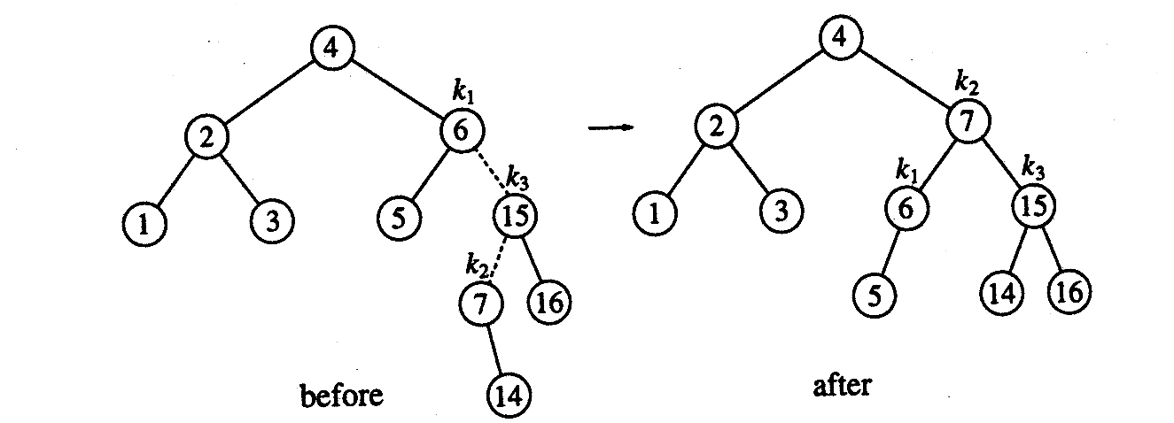
AVL Tree – Complete Example
Suppose the following elements have to be inserted further
16, 15, 14, 13, 12, 11, 10, 8
Insert 14
Insert 13
Notes:
LR Rotation → First right then left

Slide 56
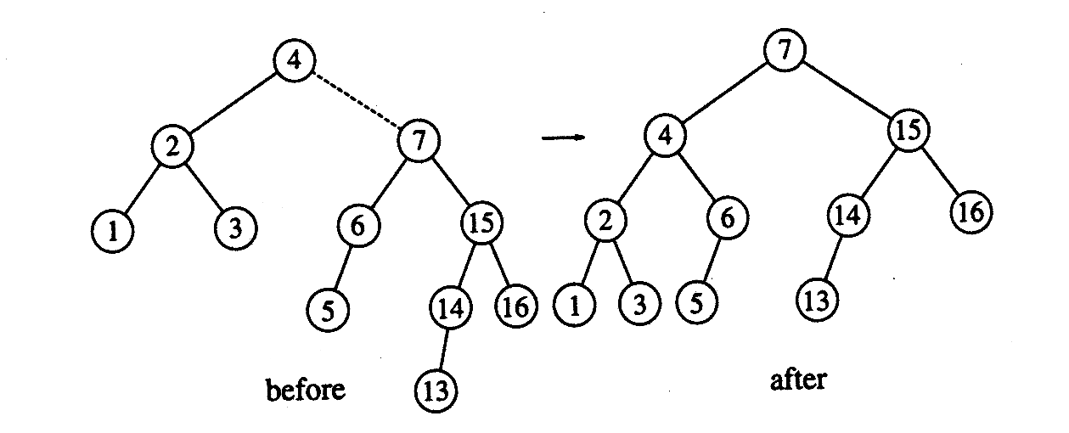
AVL Tree – Complete Example
Suppose the following elements have to be inserted further
16, 15, 14, 13, 12, 11, 10, 8
Insert 13
Insert 12
Notes:
LL case

Slide 57
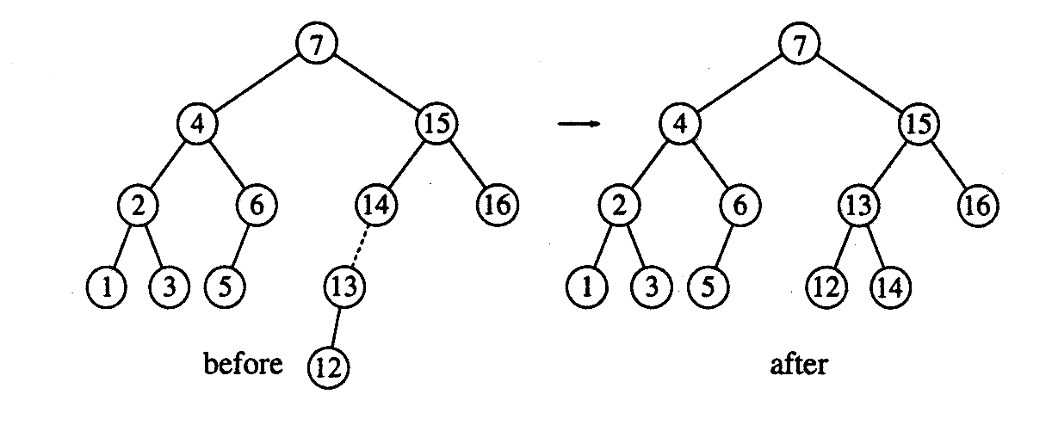
AVL Tree – Complete Example
Suppose the following elements have to be inserted further
16, 15, 14, 13, 12, 11, 10, 8
Insert 12
Insert 11, 10
Notes:
LL case

Slide 58
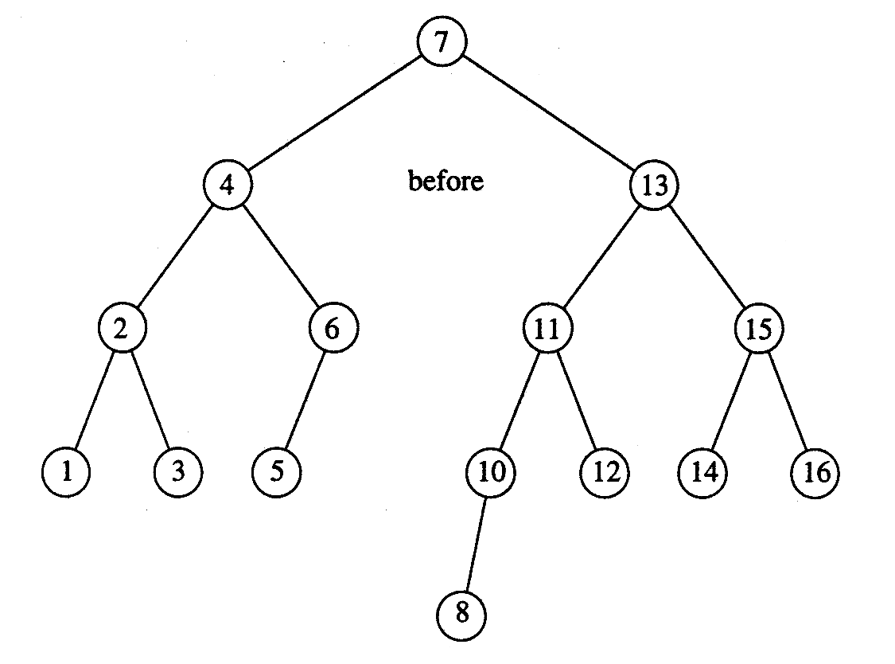
AVL Tree – Complete Example
Suppose the following elements have to be inserted further
16, 15, 14, 13, 12, 11, 10, 8
Insert 11, 10 then 8
Notes:
LL case

Slide 59
AVL Tree Implementation

Slide 60
AVL Trees: Implementation
struct AvlNode {
ElementType Element;
AvlTree Left;
AvlTree Right;
int Height;
};
typedef struct AvlNode *Position;
typedef struct AvlNode *AvlTree;
AvlTree MakeEmpty( AvlTree T );
Position Find( ElementType X, AvlTree T );
Position FindMin( AvlTree T );
Position FindMax( AvlTree T );
AvlTree Insert( ElementType X, AvlTree T );
AvlTree Delete( ElementType X, AvlTree T );
ElementType Retrieve( Position P );

Slide 61
AVL Trees: Implementation
int Height(Position P )
{
if( P == NULL )
return -1;
else
return P->Height;
}

Slide 62
AVL Trees: Insert Function
AvlTree Insert( ElementType X, AvlTree T ) {
if ( T == NULL ) { /* Create and return a one-node tree */
T = new AvlNode;
T->Element = X;
T->Left = T->Right = NULL;
}
else if( X < T->Element ) {
T->Left = Insert( X, T->Left );
if( Height( T->Left ) - Height( T->Right ) == 2 )
if( X < T->Left->Element )
T = SingleRotateWithLeft( T ); // RR rotation
else
T = DoubleRotateWithLeft( T ); // RL rotation
}
else if( X > T->Element ) {
T->Right = Insert( X, T->Right );
if( Height( T->Right ) - Height( T->Left ) == 2 )
if( X > T->Right->Element )
T = SingleRotateWithRight( T ); // LL rotation
else
T = DoubleRotateWithRight( T ); // LR rotation
} /* Else X is in the tree already; we'll do nothing */
T->Height = Max( Height( T->Left ), Height( T->Right ) ) + 1;
return T;
}

Slide 63
AVL Trees: Insert Function
AvlTree Insert( ElementType X, AvlTree T ) {
if ( T == NULL ) { /* Create and return a one-node tree */
T = new AvlNode;
T->Element = X;
T->Left = T->Right = NULL;
}
else if( X < T->Element ) {
T->Left = Insert( X, T->Left );
if( Height( T->Left ) - Height( T->Right ) == 2 )
if( X < T->Left->Element )
T = SingleRotateWithLeft( T ); // RR rotation
else
T = DoubleRotateWithLeft( T ); // RL rotation
}
else if( X > T->Element ) {
T->Right = Insert( X, T->Right );
if( Height( T->Right ) - Height( T->Left ) == 2 )
if( X > T->Right->Element )
T = SingleRotateWithRight( T ); // LL rotation
else
T = DoubleRotateWithRight( T ); // LR rotation
} /* Else X is in the tree already; we'll do nothing */
T->Height = Max( Height( T->Left ), Height( T->Right ) ) + 1;
return T;
}
if ( T == NULL ) { /* Create and return a one-node tree */
T = new AvlNode;
T->Element = X;
T->Left = T->Right = NULL;
}

Slide 64
AVL Trees: Insert Function
AvlTree Insert( ElementType X, AvlTree T ) {
if ( T == NULL ) { /* Create and return a one-node tree */
T = new AvlNode;
T->Element = X;
T->Left = T->Right = NULL;
}
else if( X < T->Element ) {
T->Left = Insert( X, T->Left );
if( Height( T->Left ) - Height( T->Right ) == 2 )
if( X < T->Left->Element )
T = SingleRotateWithLeft( T ); // RR rotation
else
T = DoubleRotateWithLeft( T ); // RL rotation
}
else if( X > T->Element ) {
T->Right = Insert( X, T->Right );
if( Height( T->Right ) - Height( T->Left ) == 2 )
if( X > T->Right->Element )
T = SingleRotateWithRight( T ); // LL rotation
else
T = DoubleRotateWithRight( T ); // LR rotation
} /* Else X is in the tree already; we'll do nothing */
T->Height = Max( Height( T->Left ), Height( T->Right ) ) + 1;
return T;
}
else if( X < T->Element ) {
T->Left = Insert( X, T->Left );
if( Height( T->Left ) - Height( T->Right ) == 2 )
if( X < T->Left->Element )
T = SingleRotateWithLeft( T ); // RR rotation
else
T = DoubleRotateWithLeft( T ); // RL rotation
}

Slide 65
AVL Trees: Insert Function
AvlTree Insert( ElementType X, AvlTree T ) {
if ( T == NULL ) { /* Create and return a one-node tree */
T = new AvlNode;
T->Element = X;
T->Left = T->Right = NULL;
}
else if( X < T->Element ) {
T->Left = Insert( X, T->Left );
if( Height( T->Left ) - Height( T->Right ) == 2 )
if( X < T->Left->Element )
T = SingleRotateWithLeft( T );
else
T = DoubleRotateWithLeft( T );
}
else if( X > T->Element ) {
T->Right = Insert( X, T->Right );
if( Height( T->Right ) - Height( T->Left ) == 2 )
if( X > T->Right->Element )
T = SingleRotateWithRight( T ); // LL rotation
else
T = DoubleRotateWithRight( T ); // LR rotation
} /* Else X is in the tree already; we'll do nothing */
T->Height = Max( Height( T->Left ), Height( T->Right ) ) + 1;
return T;
}
else if( X > T->Element ) {
T->Right = Insert( X, T->Right );
if( Height( T->Right ) - Height( T->Left ) == 2 )
if( X > T->Right->Element )
T = SingleRotateWithRight( T ); // LL rotation
else
T = DoubleRotateWithRight( T ); // LR rotation
}
/* Else X is in the tree already; we'll do nothing */

Slide 66
AVL Trees: Insert Function
AvlTree Insert( ElementType X, AvlTree T ) {
if ( T == NULL ) { /* Create and return a one-node tree */
T = new AvlNode;
T->Element = X;
T->Left = T->Right = NULL;
}
else if( X < T->Element ) {
T->Left = Insert( X, T->Left );
if( Height( T->Left ) - Height( T->Right ) == 2 )
if( X < T->Left->Element )
T = SingleRotateWithLeft( T ); // RR rotation
else
T = DoubleRotateWithLeft( T ); // RL rotation
}
else if( X > T->Element ) {
T->Right = Insert( X, T->Right );
if( Height( T->Right ) - Height( T->Left ) == 2 )
if( X > T->Right->Element )
T = SingleRotateWithRight( T ); // LL rotation
else
T = DoubleRotateWithRight( T ); // LR rotation
} /* Else X is in the tree already; we'll do nothing */
T->Height = Max( Height( T->Left ), Height( T->Right ) ) + 1;
return T;
}
T->Height = Max( Height( T->Left ), Height( T->Right ) ) + 1;
return T;

Slide 67
AVL Trees: LL Rotation
Position SingleRotateWithRight( Position K1 ) {
Position K2;
K2 = K1->Right; // K1: node whose balance factor is violated
K1->Right = K2->Left;
K2->Left = K1;
K1->Height = Max( Height(K1->Left), Height(K1->Right) ) + 1;
K2->Height = Max( Height(K2->Right), K1->Height ) + 1;
return K2; /* New root */
}
K1
K2
20
K2
Left Rotation
40
40
K1
10
20
50
30
50
10
30
60
60

Slide 68
AVL Trees: RR Rotation
Position SingleRotateWithLeft( Position K1 ) {
Position K2;
K2 = K1->Left; // K1: node whose balance factor is violated
K1->Left = K2->Right;
K2->Right = K1;
K1->Height = Max( Height(K1->Left), Height(K1->Right) ) + 1;
K2->Height = Max( Height(K2->Left), K1->Height ) + 1;
return K2; /* New root */
}

Slide 69
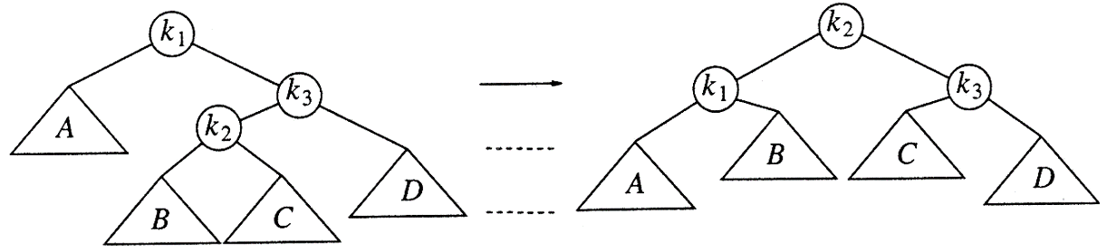
AVL Trees: LR Rotation
Position DoubleRotateWithRight( Position K1)
{
/* RR rotation between K3 and K2 */
K1->Right = SingleRotateWithLeft( K1->Right );
/* LL rotation between K1 and K2 */
return SingleRotateWithRight( K1 );
}
Single Right Rotation at K3
Single Left rotation at K1

Slide 70
LR Rotation
Adding node 22
Requires double rotation!
40
40
20
50
20
50
10
30
60
10
30
60
25
35
25
35
22

Slide 71
LR Rotation
40
40
K1
K1
20
50
20
50
K3
K2
10
30
60
10
25
60
K2
K3
25
35
22
30
22
35

Slide 72
LR Rotation
40
40
K1
K2
20
50
25
50
K2
K1
K3
10
25
60
20
30
60
K3
22
30
10
22
35
35

Slide 73
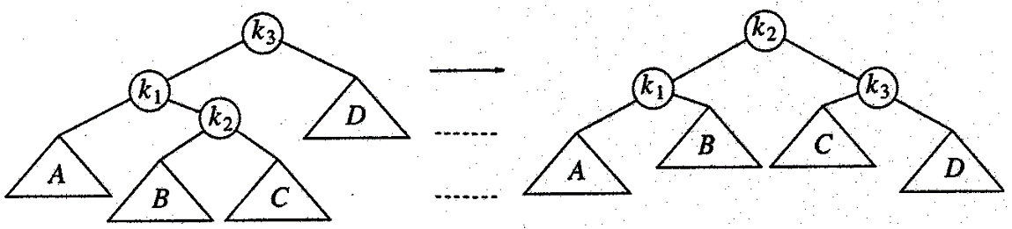
AVL Trees: RL Rotation
Position DoubleRotateWithLeft( Position K3 )
{
/* LL rotation between K1 and K2 */
K3->Left = SingleRotateWithRight( K3->Left );
/* RR rotation between K3 and K2 */
return SingleRotateWithLeft( K3 );
}
Single Left Rotation at K1
Single Right rotation at K3

Slide 74
AVL Tree Deletion

Slide 75
AVL Tree: Deletion
Goal: To preserve the height balance property of BST after deletion
Step 1: Perform BST delete
Maintains the BST property
May break the balance factors of ancestors!
Step 2: Fix the AVL tree balance constraint
Perform transformation on the tree by means of rotation such that
BST property is maintained
Transformation fixes any balance factors that are < -1 or > 1

Slide 76
AVL Tree: Deletion
BST deletion breaks the invarialants of AVL tree
7
7
Delete(9)
4
9
4
3
3
NOT an AVL tree!

Slide 77
AVL Tree: Deletion
BST deletion breaks the balance factors of incestors
7
0
1
7
1
Delete(3)
4
9
0
1
4
9
1
0
0
0
3

Slide 78
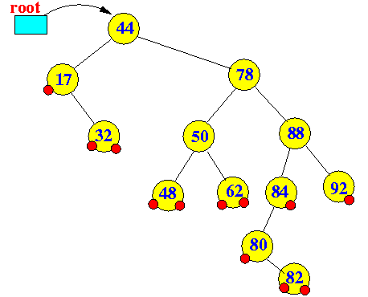
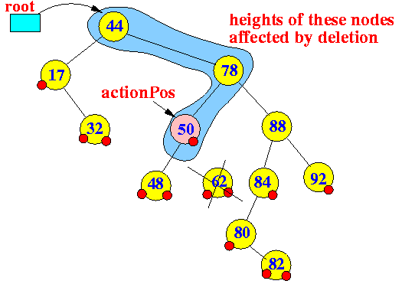
AVL Tree: BST Deletion
Case 1: Node to be deleted has degree 0 (i.e., leaf node)
Consider deleting node containing 62
Action position: Reference to parent node from which a node has been physically removed
First node whose height may be changed by deletion

Slide 79
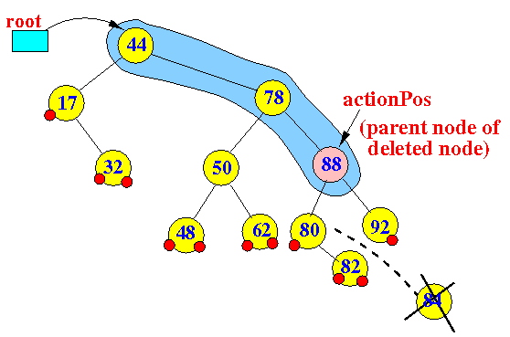
AVL Tree: BST Deletion
Case 2: Node to be deleted has degree 1 (i.e., node with one child)
Consider deleting node containing 84

Slide 80
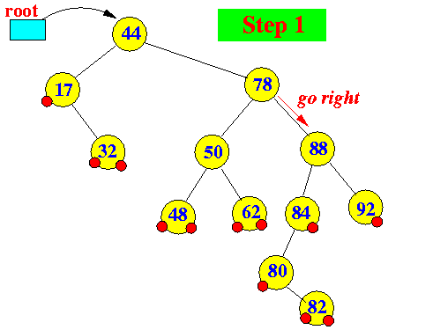
AVL Tree: BST Deletion
Case 3: Node p to be deleted has two children (i.e., degree 2)
Replace node p with the minimum object in the right subtree
Delete that object from the right subtree
Consider deleting node containing 78

Slide 81
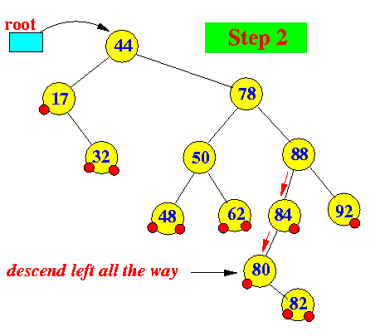
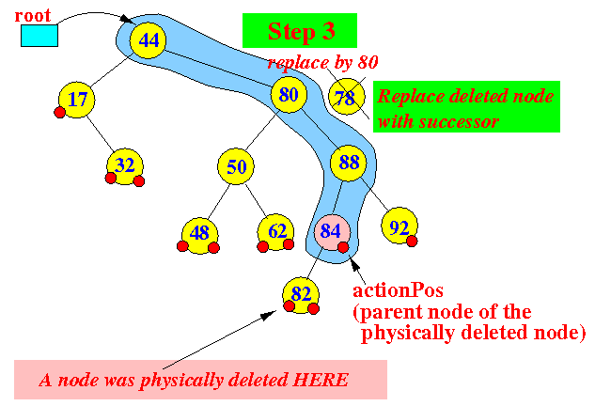
AVL Tree: BST Deletion
Case 3: Node p to be deleted has two children (i.e., degree 2)
Replace node p with the minimum object in the right subtree
Delete that object from the right subtree
Consider deleting node containing 78

Slide 82
AVL Tree Deletion
After removing a child, delete must check for imbalance
Similar to insert operation
Rotations can be used to re-balance an out-of-balanced AVL tree
LL, RR, LR and RL rotations

Slide 83
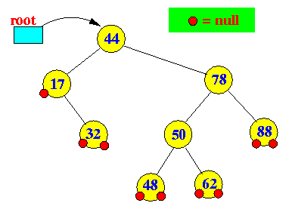
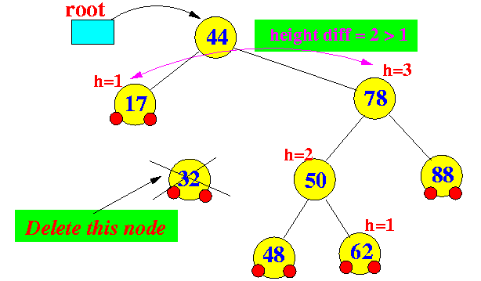
AVL Tree Deletion: Example
Deleting a node from an ALV tree can cause imbalance
Consider deleting node 32

Slide 84
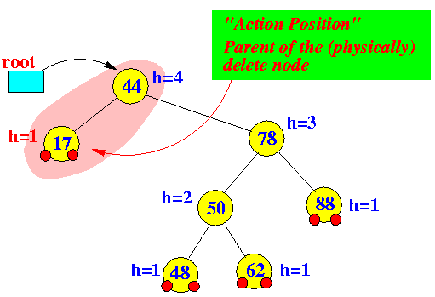
AVL Tree Deletion: Example
The balance factor changes at only nodes between the root and the parent node of the physically deleted node
Starting at the action position find the first imbalanced node

Slide 85
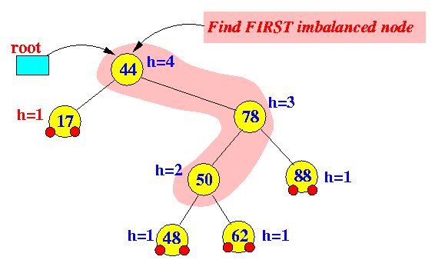
AVL Tree Deletion: Example
Perform rotation using shaded nodes
Node a is the first imbalanced node from the action position
Node c is the child node of node a that has the higher height
Node b is the child node of node b that has the higher height
a
c
b

Slide 86

AVL Tree Deletion: Example
The tree after LR rotation

Slide 87
AVL Tree Deletion: Multiple Imbalance
The imbalance at the first imbalance node due to a deletion operation can be restored using rotation
Resulting subtree does not have the same height as the original subtree !!!
Nodes that are further up the tree may require re-balancing
Deleting a node may cause more than one AVL imbalance !!!
Unfortunately, delete may cause O(h) imbalances
Insertions will only cause one imbalance that must be fixed

Slide 88

AVL Tree Deletion: Example
Consider the following AVL tree
Original height of the subtree rooted at 75 is 2

Slide 89


AVL Tree Deletion: Example
Node with value 80 is deleted
The imbalance is on left-left subtree
Imbalance can be fixed using RR rotation

Slide 90

AVL Tree Deletion: Example
Node 50 requires re-balancing
The imbalance is on left-left subtree
Imbalance can be fixed using RR rotation – Home work!!
Resultant height of the subtree is 1

Slide 91

AVL Tree Deletion: Example
Consider the following AVL tree
Suppose node with value 1 is deleted

Slide 92

AVL Tree Deletion: Example
While its previous parent, 2, is not unbalanced, its grandparent 3 is
The imbalance is in the right-right subtree

Slide 93

AVL Tree Deletion: Example
While its previous parent, 2, is not unbalanced, its grandparent 3 is
The imbalance is in the right-right subtree
Imbalance can be fixed using LL rotation

Slide 94

AVL Tree Deletion: Example
The subtrees of node 5 is now balanced
Recursing to the root, however, 8 is also unbalanced
The imbalance is in right-left subtree

Slide 95

AVL Tree Deletion: Example
The node with value 8 is unbalanced
The imbalance is in right-left subtree
LR rotation can fix imbalance

Slide 96

AVL Tree Deletion: Example
Root 21 is still imbalanced
The imbalance is in right-right subtree

Slide 97

AVL Tree Deletion: Example
Root 21 is still imbalanced
The imbalance is in right-right subtree
LL rotation can fix the imbalance

Slide 98
Any Question So Far?

Slide 99
Quiz (Section A) – 14 Nov 2019
Construct an AVL tree with the following input
70, 80, 90, 60, 50, 55, 53, 49

Slide 100
Quiz (Section B) – 11 Nov 2019
Construct an AVL tree with the following input
60, 70, 80, 50, 40, 45, 43, 39

Slide 101
Quiz (Section C) – 11 Nov 2019
Construct an AVL tree with the following input
80, 90, 100, 70, 60, 65, 63, 59

Slide 102




Fixing Imbalance By Rotation
Let the node that needs rebalancing be a
Violation during insertion may occur in four cases
Outside cases (Single Rotation)
Right rotation
Left rotation
Inside cases (Double Rotation)
Right-left rotation
Left-right rotation

Slide 103
When to Perform Right Rotation (RR)
Let the node that needs rebalancing be a
Case RR
Insertion into left subtree of left child of node a
Left tree is heavy (i.e., h_{left} > h_{right} )
First R is for left child of node a
Second R is for left subtree of left child of node a

